Slide 1
Data Visualization
Visualization with Purpose: Accessible Data Visualization
Data Sciences Institute, University of Toronto

Slide 2
We will...
Discuss the real-world impacts of inaccessible data visualization
Explore practical tips and resources that we can use to improve the accessibility of our data visualizations, especially relating to:
Colour
Text
Image Descriptions
Getting our visualizations to the intended audiences

Slide 3
Case Study: Who gets to use data visualizations?

Slide 4
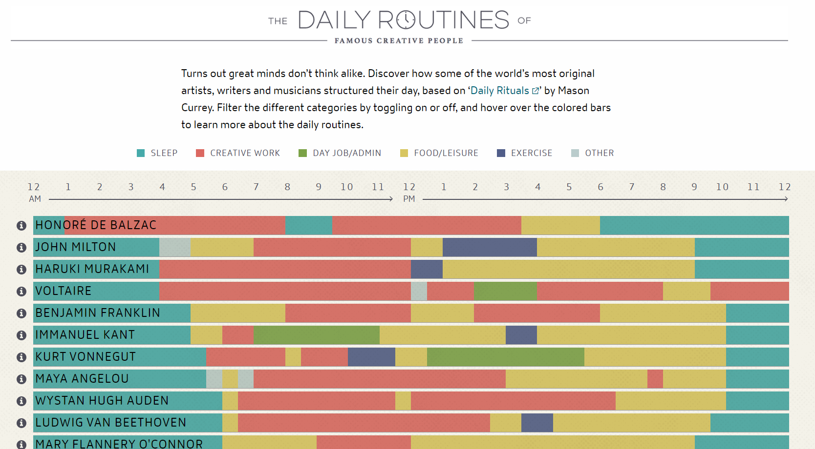
‘The Daily Routines of Famous Creative People’ Visualization
(Click image to view interactive visualization)
Notes:
REFERENCES:
Currey, M. (2013). The Daily Routines of Famous Creative People—Citrix Podio. Podio.Com. https://www.podio.com/creative-routines

Slide 5
‘The Daily Routines of Famous Creative People’ Visualization
The ‘Daily Routines’ plot is often used as an example of ‘good’ data visualization
It includes its data source (substantive qualities), uses an appropriate plot type for comparison (perceptual qualities), and limits its colour scheme (aesthetic qualities)
Notes:
REFERENCES:
Currey, M. (2013). The Daily Routines of Famous Creative People—Citrix Podio. Podio.Com. https://www.podio.com/creative-routines

Slide 6
Questioning assumptions
Sarah L. Fossheim, a developer and designer, was curious about how the visualization would be perceived by people with deuteranopia (a type of red-green colourblindness) and achromatopsia (partial or total lack of colour vision)
(Fossheim, 2020)
Notes:
REFERENCES:
Currey, M. (2013). The Daily Routines of Famous Creative People—Citrix Podio. Podio.Com. https://www.podio.com/creative-routines
Sarah Fossheim (they/them) site https://fossheim.io/
Fossheim, S. L. (2020, January). An intro to designing accessible data visualizations. Sarah L. Fossheim. https://fossheim.io/writing/posts/accessible-dataviz-design/

Slide 7
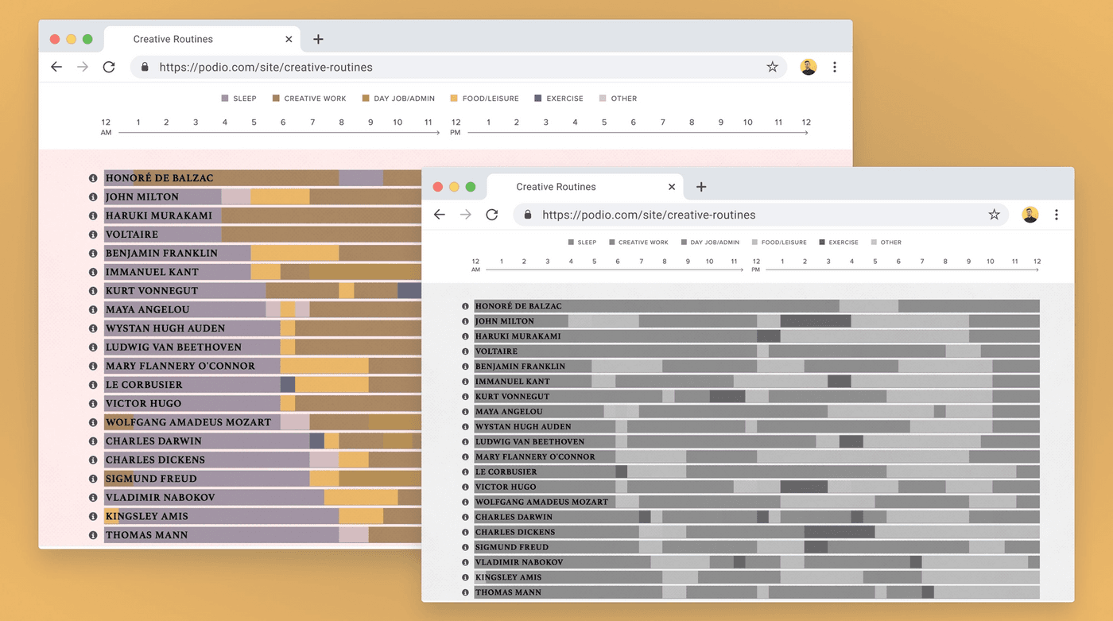
A different picture
(Fossheim, 2020)
Notes:
NOTES:
Fossheim created the images here, showing the ‘daily routines of famous creative people’ data viz as it would be perceived by people with deuteranopia (left, back) and achromatopsia (right, front)
REFERENCES:
Currey, M. (2013). The Daily Routines of Famous Creative People—Citrix Podio. Podio.Com. https://www.podio.com/creative-routines
Fossheim, S. L. (2020, January). An intro to designing accessible data visualizations. Sarah L. Fossheim. https://fossheim.io/writing/posts/accessible-dataviz-design/

Slide 8
A different picture
Some of the colours end up looking similar or the same, and the lack of specific labels on the plot makes it impossible for individuals with either form of colourblindness to make sense of the data the creator was trying to present
This data visualization is not accessible to certain people
(Fossheim, 2020)
Notes:
REFERENCES:
Fossheim, S. L. (2020, January). An intro to designing accessible data visualizations. Sarah L. Fossheim. https://fossheim.io/writing/posts/accessible-dataviz-design/

Slide 9
In the case of the ‘Daily Routines of Famous Creative People’ visualization, a lack of accessibility is an inconvenience, but one with a relatively limited scope
But what about when the ability to make sense of the data being shared visually has an impact on people’s daily lives and wellbeing?
Notes:
REFERENCES:

Slide 10
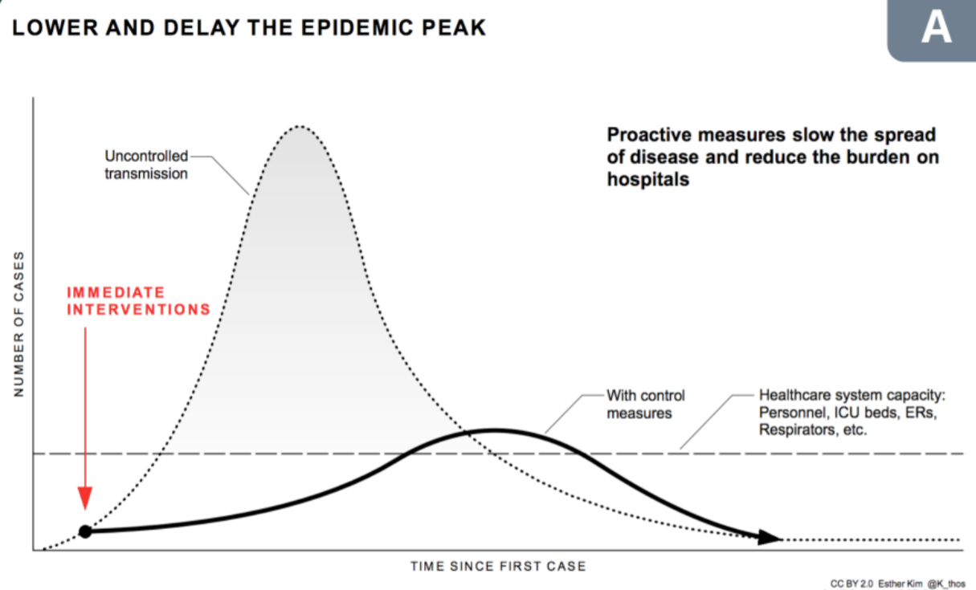
‘Flattening the Curve’
(Lundgard & Satyanarayan, 2022)
Notes:
NOTES:
Variations of plots similar to the image shown here - showing the need to ‘flatten the curve’ of COVID-19 transmission with control measures to avoid overwhelming healthcare systems - have become incredibly common since March of 2020
REFERENCES:
Lundgard, A., & Satyanarayan, A. (2022). Accessible Visualization via Natural Language Descriptions: A Four-Level Model of Semantic Content. https://doi.org/10.1109/TVCG.2021.3114770

Slide 11
‘Flattening the Curve’
Data visualizations such as this one are an efficient and effective form of communicating public health information, but not to everyone
Activity: In what ways is this data visualization inaccessible, and to whom? Let’s discuss!
(Lundgard & Satyanarayan, 2022)
Notes:
NOTES:
Note again that this visualization meets most of our standards for substantively/perceptually/aesthetically ‘good’ data visualization
Some accessibility concerns with this image: lots of text-as-image (gets blurry if you zoom, might not be processed by a screen reader); no alt text/caption for screen readers, small font size
REFERENCES:
Lundgard, A., & Satyanarayan, A. (2022). Accessible Visualization via Natural Language Descriptions: A Four-Level Model of Semantic Content. https://doi.org/10.1109/TVCG.2021.3114770

Slide 12
Pandemic information and people with visual impairments
Graphical and spatial visualizations of pandemic data are everywhere, and help the public see epidemiological trends at a glance, but most of these images are inaccessible
Lack of alternative descriptive text means that people using screen readers cannot access the data
Tactile or braille versions of COVID-19 data visualizations are rare and often expensive to create
From Lundgard & Satyanarayan (2022), “for readers with visual disabilities… inaccessible visualizations are, at best, demeaning and, at worst, damaging to health.”
Notes:
NOTES:
REFERENCES:
Lundgard, A., & Satyanarayan, A. (2022). Accessible Visualization via Natural Language Descriptions: A Four-Level Model of Semantic Content. https://doi.org/10.1109/TVCG.2021.3114770
Ehrenkranz, M. (2020, April 9). Vital Coronavirus Information Is Failing the Blind and Visually Impaired. Vice. https://www.vice.com/en/article/4ag9wb/vital-coronavirus-information-is-failing-the-blind-and-visually-impaired

Slide 13
Failing to consider best practices for accessible design means that our data visualization will not have the desired positive effect on all of our audience, and may even have a harmful effect by excluding them from important data
As professionals and academics who went to communicate our data visually, we have a responsibility to prioritize accessibility
Notes:
REFERENCES:

Slide 14
Government of Canada Principles for Accessible Design
The Government of Canada provides four broad goals for what we should try to accomplish with accessible design:
Make information clear, concise and easy to use
Present information in predictable, barrier‑free ways
Provide barrier‑free ways for people to interact with you
Make sure technology-based products work with assistive technologies and devices
(Treasury Board of Canada, 2020)
Notes:
REFERENCES:
Treasury Board of Canada. (2020, October 23). Making communications accessible in the Government of Canada. Government of Canada. https://www.canada.ca/en/treasury-board-secretariat/topics/government-communications/making-communications-accessible.html

Slide 15
So how do we incorporate these accessibility goals into our data visualization practices?

Slide 16
Colour

Slide 17
Using colour
Colour is one of the most useful features of many data visualizations
We have to be aware of the ways that colour can be perceived differently by the audiences of our images

Slide 18
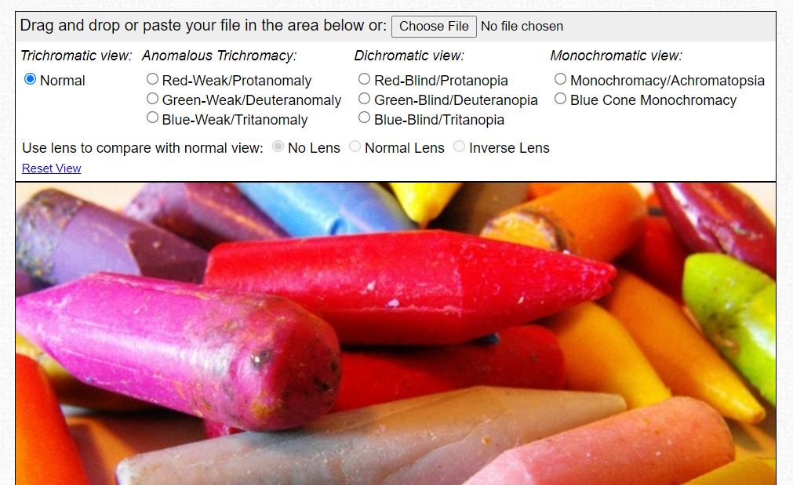
Resource: Colour Blindness Simulator
The Colour Blindness Simulator allows you to upload an image and apply various filters to check how its colours would be perceived by people with various types of colourblindness

Slide 19
Brightness and Contrast
Overly bright colours can be painful to look at, and overwhelming for people with sensory issues and people on the autism spectrum
Contrast is the ratio between the brightness of two different colours
A higher contrast generally makes colours and objects in our data visualizations easier to tell apart
LOW CONTRAST
HIGH CONTRAST
Notes:
REFERENCES:
Ward, J., Hoadley, C., Hughes, J. E. A., Smith, P., Allison, C., Baron-Cohen, S., & Simner, J. (2017). Atypical sensory sensitivity as a shared feature between synaesthesia and autism. Scientific Reports, 7(1), 41155. https://doi.org/10.1038/srep41155
https://a11y.canada.ca/docs/posters/AutismSpect-en.pdf
Fossheim, S. L. (2020, January). An intro to designing accessible data visualizations. Sarah L. Fossheim. https://fossheim.io/writing/posts/accessible-dataviz-design/

Slide 20
Resource: Check Contrast
WebAIM offers an online tool that lets you enter in two colour values and check if they are a ‘pass’ or ‘fail’ according to Web Content Accessibility Guidelines standards for contrast
Colours can be picked from a dropper or using hexadecimal code
The tool delivers separate contrast scores for normal text, large text, and graphical components

Slide 21
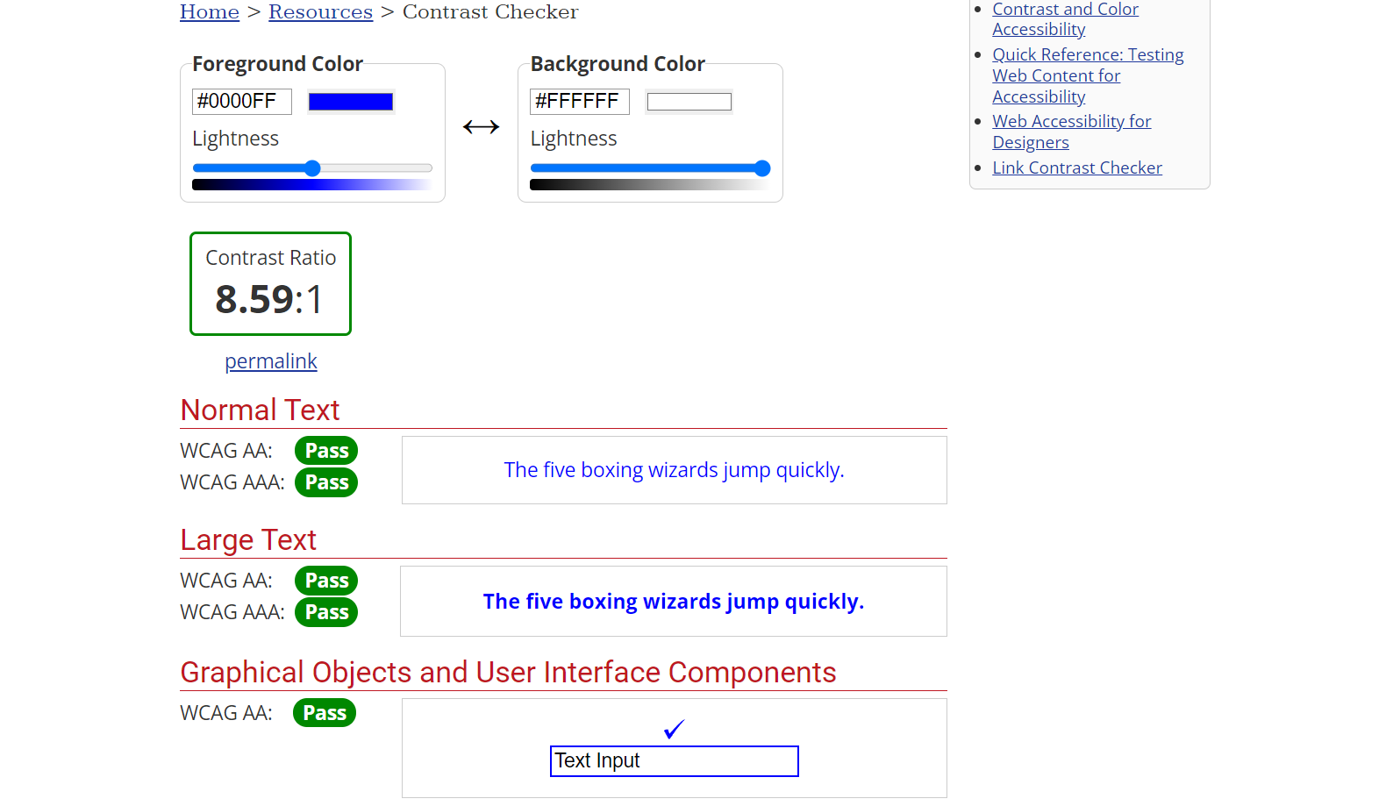
Check Contrast
Notes:
NOTES:
This image shows the default test and output from the online webAIM contrast checker tool

Slide 22
Resource: Viridis package
Viridis was made as an R package designed to make plots easier to read by those with colourblindness, and to maintain contrast so plots are readable in grayscale (eg. in print)
Viridis can be used in Python with matplotlib as a colormap https://matplotlib.org/stable/users/explain/colors/colormaps.html
Notes:
REFERENCES:
Rudis, B., Ross, N., & Garnier, S. (2021). Viridis color maps [R]. https://cran.r-project.org/web/packages/viridis/vignettes/intro-to-viridis.html

Slide 23
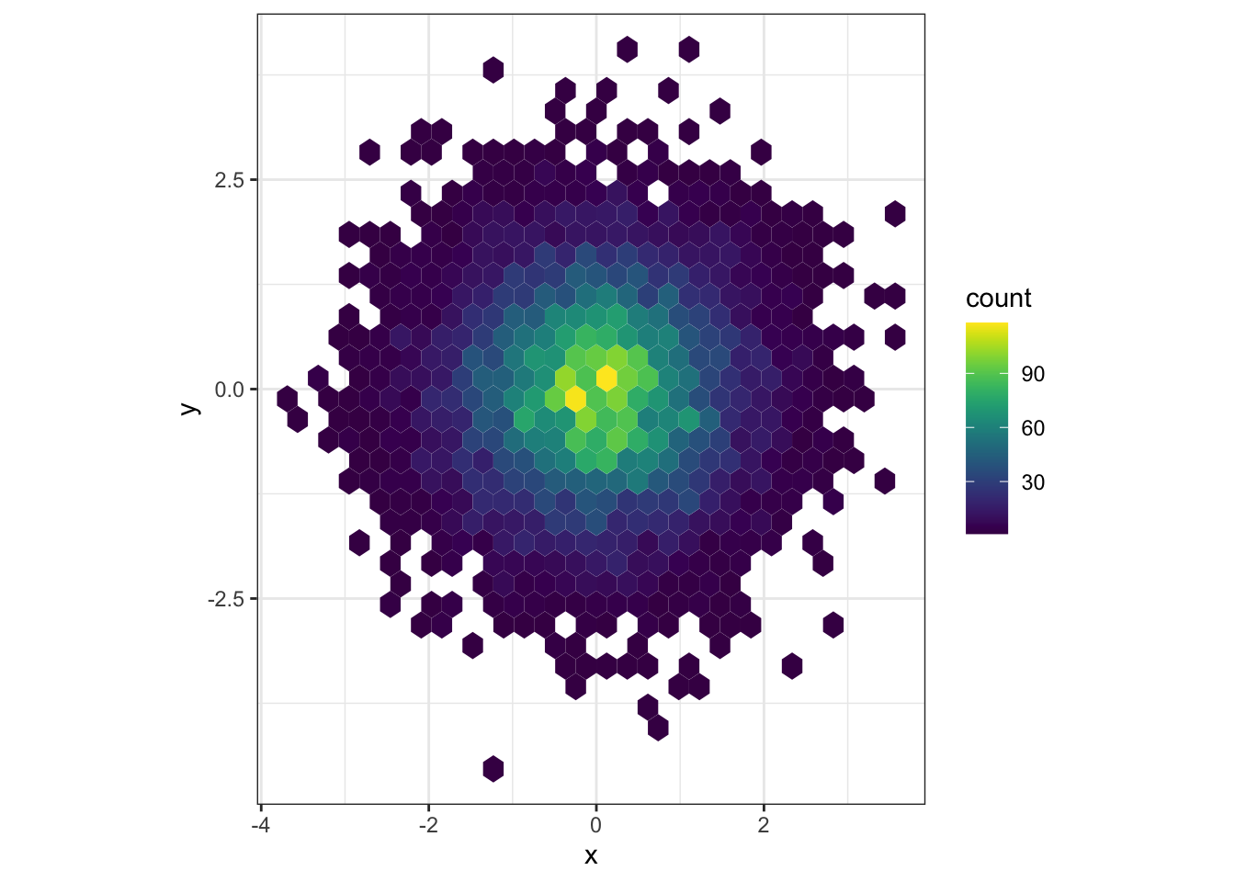
Viridis package - Example
Notes:
REFERENCES:
Rudis, B., Ross, N., & Garnier, S. (2021). Viridis color maps [R]. https://cran.r-project.org/web/packages/viridis/vignettes/intro-to-viridis.html

Slide 24

Viridis package - As perceived with colourblindness
 | Default Colour Palettes | viridis Default Colour Palette
Base
Green-Blind (Deuteranopia)
Red-Blind (Protanopia)
Desaturated
Notes:
NOTES:
Viridis colour palettes show greater contrast and thus make data easier to perceive by people with varying forms of colourblindness, or when printed without colour
REFERENCES:
Rudis, B., Ross, N., & Garnier, S. (2021). Viridis color maps [R]. https://cran.r-project.org/web/packages/viridis/vignettes/intro-to-viridis.html

Slide 25
Moving beyond colour
Even when we make use of best practice for accessible use of colour in our data visualization, we should avoid relying only on colour, where possible
Think back to our ‘Daily Habits’ example - use of patterns or textures in addition to colour on our bars could have made the visualization more accessible to people with visual impairments, even with the current colour scheme

Slide 26
Text

Slide 27
Labels and legends
If we want to minimize colours and patterns, data labels (on individual data points or on bars in a bar graph) can make visualizations easier to follow
Every visual element on our graph should be clearly described in a legend; additional, brief written descriptions of visual elements can also reduce anxiety for our audiences
(Fossheim, 2020)
Notes:
REFERENCES:
Fossheim, S. L. (2020, January). An intro to designing accessible data visualizations. Sarah L. Fossheim. https://fossheim.io/writing/posts/accessible-dataviz-design/

Slide 28
Fonts and typefaces
A typeface is a set of text characters (eg. Arial, Times New Roman)
A font is a subset of a typeface (eg. 12 point Arial in italic)
Certain typefaces and fonts are considered more accessible than others in design and data visualization contexts
(WebAIM, 2020)
Notes:
REFERENCES:
WebAIM. (2020). WebAIM: Typefaces and Fonts. WebAIM. https://webaim.org/techniques/fonts/

Slide 29
Typeface
There is no single ‘right’ typeface or font to use, but generally sans-serif fonts are more accessible for people with cognitive disabilities
Typefaces identified as easier to read for people with dyslexia include:
Helvetica Courier Arial Verdana
We should also avoid overwhelming users by switching between too many different typefaces in one graphic
(WebAIM, 2020; Rello & Baeza-Yates, 2013)
Notes:
REFERENCES:
Rello, L., & Baeza-Yates, R. (2013). Good fonts for dyslexia. Proceedings of the 15th International ACM SIGACCESS Conference on Computers and Accessibility, 1–8. https://doi.org/10.1145/2513383.2513447
WebAIM. (2020, October 27). WebAIM: Typefaces and Fonts. WebAIM. https://webaim.org/techniques/fonts/

Slide 30
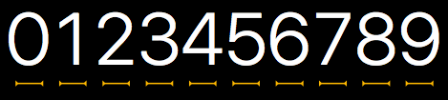
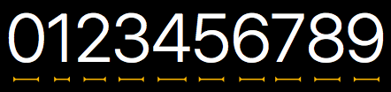
Font size and spacing
Text on our data visualizations should be at least 12 point size or greater, if possible
Spacing also affects the readability of text on our visualizations
Monospaced text (each character takes the same amount of space) is more widely accessible than proportionally spaced text (each character only takes the space it needs)
Monospaced Text
Proportionally Spaced Text
(Shared Services Canada, 2021; Rello & Baeza-Yates, 2013)
Notes:
REFERENCES:
Shared Services Canada. (2021). Design principles for users with cognitive disabilities. Government of Canada. https://a11y.canada.ca/docs/posters/Cognitive-en.pdf
Rello, L., & Baeza-Yates, R. (2013). Good fonts for dyslexia. Proceedings of the 15th International ACM SIGACCESS Conference on Computers and Accessibility, 1–8. https://doi.org/10.1145/2513383.2513447
WebAIM. (2020). WebAIM: Typefaces and Fonts. WebAIM. https://webaim.org/techniques/fonts/

Slide 31
Describing data visualizations

Slide 32
Alt-text
To ensure that our data visualizations are accessible to people using a screen reader or unable to see the image, we include alternate text (alt-text)
Alt-text should convey all the essential information conveyed by an image
Generally, alt-text consists of a description of the image; if there is text in the image, alt-text should include the text
Alt-text should be in plain language and simple sentences, when possible
(University of Toronto, 2021)
Notes:
REFERENCES:
University of Toronto. (2021). Accessible Images and Multimedia | Information & Instructional Technology. https://www.utm.utoronto.ca/iits/documentation/drupal-user-guide/accessible-images-and-multimedia

Slide 33
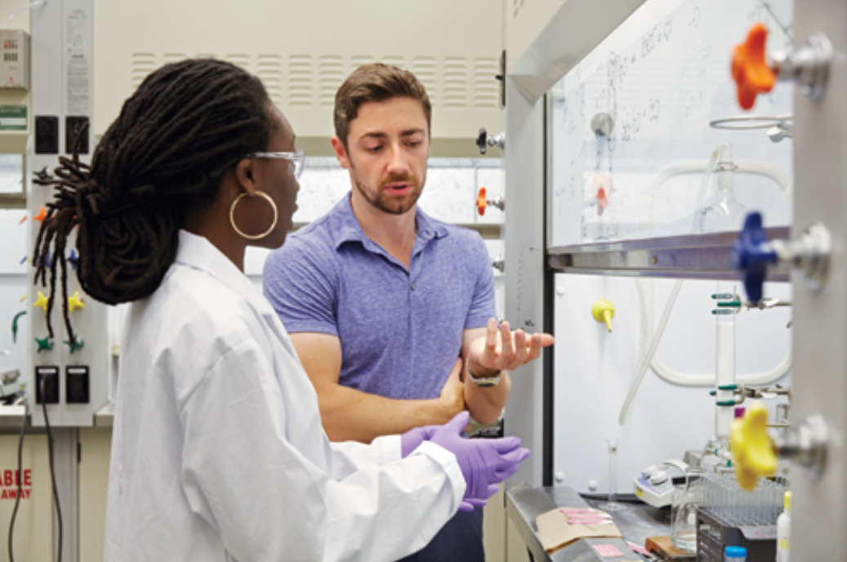
Activity: Alt-text
What would be suitable alt-text for this image?
(University of Toronto, 2021)
Notes:
REFERENCES:
University of Toronto. (2021). Accessible Images and Multimedia | Information & Instructional Technology. https://www.utm.utoronto.ca/iits/documentation/drupal-user-guide/accessible-images-and-multimedia

Slide 34
Activity: Alt-text
The most appropriate alt-text can depend on the intended purpose of an image or visualization:
If the image is only for decoration: “Two scientists in discussion”
If the focus is on specific individuals: “From left-to-right: Eugenia Duodu and Patrick Gunning”
If the focus is on the actual events or contents of an image: “Professor Patrick Gunning and doctoral student Eugenia Duodo talking by a chemistry fume hood”
(University of Toronto, 2021)
Notes:
REFERENCES:
University of Toronto. (2021). Accessible Images and Multimedia | Information & Instructional Technology. https://www.utm.utoronto.ca/iits/documentation/drupal-user-guide/accessible-images-and-multimedia

Slide 35
Alt-text for graphs and plots of data
Accessibly describing data-centric images for alt-text and figure captions requires additional considerations compared to describing photos such as the previous example
Lundgard & Satyanarayan (2022) collected descriptions of sample data visualizations from graduate students and found that the descriptions could be grouped into four categories
(Lundgard & Satyanarayan, 2022)
Notes:
REFERENCES:
Lundgard, A., & Satyanarayan, A. (2022). Accessible Visualization via Natural Language Descriptions: A Four-Level Model of Semantic Content. https://doi.org/10.1109/TVCG.2021.3114770

Slide 36
Four types of descriptive content
Level | Semantic Content and Keywords
1 | Focus on chart elements such as chart type, title, axis ranges, labels, colours
2 | Descriptive statistics (eg. mean), outliers, max and min points, correlations, comparing points
3 | Complex trends, pattern synthesis, clusters, exceptions, common concepts Perceptual interpretations of the data
4 | Context and domain insights, social and political context and explanations Subjective interpretations that go beyond the data
(Lundgard & Satyanarayan, 2022)
Notes:
REFERENCES:
Lundgard, A., & Satyanarayan, A. (2022). Accessible Visualization via Natural Language Descriptions: A Four-Level Model of Semantic Content. https://doi.org/10.1109/TVCG.2021.3114770

Slide 37
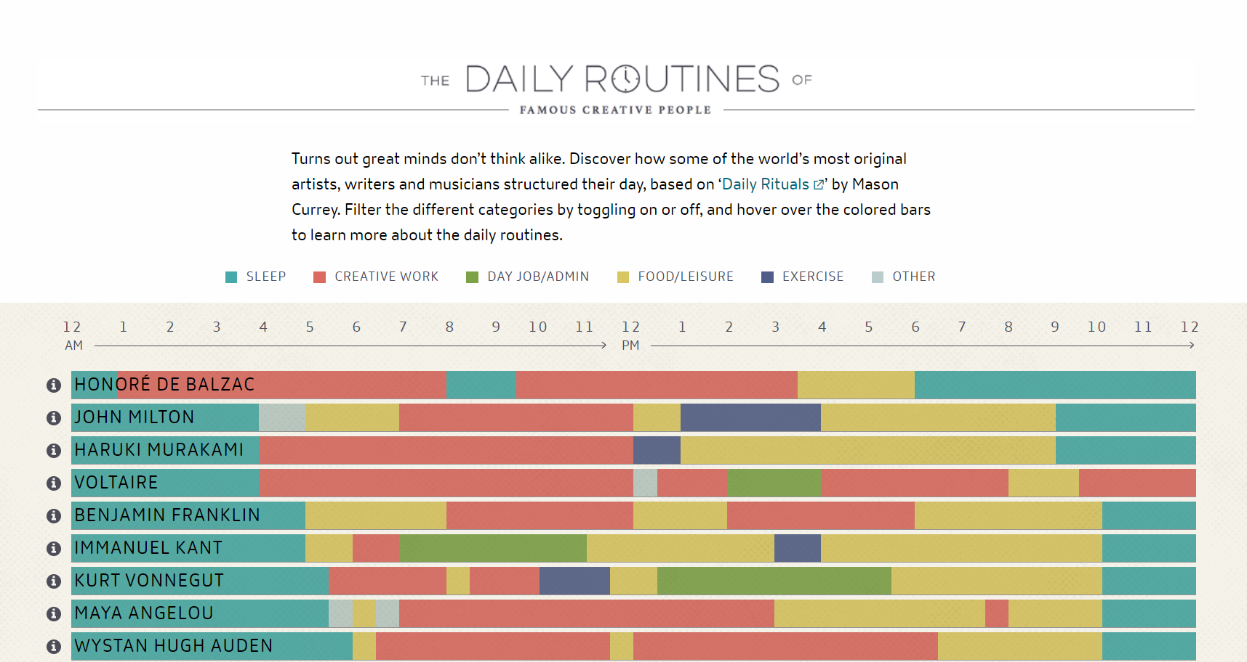
Activity: Four types of descriptive content
Describe the data visualization on this slide according to each of the four types of descriptive content (click to visit website).
Notes:
REFERENCES:
Lundgard, A., & Satyanarayan, A. (2022). Accessible Visualization via Natural Language Descriptions: A Four-Level Model of Semantic Content. https://doi.org/10.1109/TVCG.2021.3114770
Currey, M. (2013). The Daily Routines of Famous Creative People—Citrix Podio. Podio.Com. https://www.podio.com/creative-routines

Slide 38
Alt-text for graphs and plots of data
The four types of descriptive text are not equally helpful!
Both blind and sighted participants in the original study found level 1 content on its own the least helpful
Blind participants found level 4 content the least useful
Blind participants preferred descriptions to contain facts about the data, giving them the agency to interpret it for themselves, rather than editorializing by the creator
40% of blind participants thought that the most useful descriptions would combine content from multiple levels (2 and 3)
(Lundgard & Satyanarayan, 2022)
Notes:
REFERENCES:
Lundgard, A., & Satyanarayan, A. (2022). Accessible Visualization via Natural Language Descriptions: A Four-Level Model of Semantic Content. https://doi.org/10.1109/TVCG.2021.3114770

Slide 39
Can people actually access our data visualizations?
Notes:
NOTES:
Once we put in all of this effort, there’s one last big component to accessibility: making sure that the people we want to see our data viz can actually see it!
There are a couple of different elements to this

Slide 40
Cross-browser functionality
If our data visualization is going to be embedded in a web page or otherwise accessible online, it is important to check for cross-browser functionality
Our data visualization should be functional and visible in:
Chrome
Firefox
Internet Explorer 11, Microsoft Edge (Windows)
Safari (Mac/iOS)
This is especially important in some professional contexts, where browser use may be limited/regulated
(Canadian Digital Service, 2022)
Notes:
NOTES:
Especially given pandemic-induced requirements for remote work, many data visualizations are primarily shown/accessed online
REFERENCES:
Canadian Digital Service. (2022). Tools and resources—Canadian Digital Service. Canadian Digital Service. https://digital.canada.ca/a11y/tools-and-resources/

Slide 41
Cost and accessibility
If our data visualization is intended to reach the public or a particular subgroup of the public, the cost of accessing our visualization (and surrounding content) is an accessibility issue
Eg. Most academic publications require a subscription
To maximize the accessibility of our data products, we can consider:
Open Access (Per University of BC Libraries, “a range of practices through which research outputs are distributed online, free of cost or other access barriers”)
Creative Commons licenses (standard and simple licenses to facilitate sharing and reuse of work)
(University of British Columbia, 2021)
Notes:
REFERENCES:
The University of British Columbia. (2021). Open Access Basics. Program for Open Scholarship and Education. https://pose.open.ubc.ca/open-access/pathways-to-open/open-access-basics/

Slide 42
When in doubt about the accessibility of our data visualizations…
…show somebody!
User testing and gathering feedback, even informally, is the best way to understand whether our data visualizations are accessible and understandable to our intended audiences
Notes:
REFERENCES:

Slide 43
For more resources…
The Government of Canada’s Digital Accessibility Toolkit contains guides and graphics in plain language to facilitate designing with accessibility in mind
The AccessAbility handbook is a detailed guide to accessible practices in graphic design, with useful insights for data visualization
Notes:
REFERENCES:
https://www.rgd.ca/resources/accessibility/access

Slide 44
Next...
Data Visualization as Advocacy
Examples of data visualization used for advocacy, and best practices
Form, representation, and giving credit as means of incorporating advocacy into our own data visualization practices
Moving beyond matplotlib – other data viz libraries in Python

